Slide 1

Jui-Lin Chang

Slide 2
TensorFlow Quantum: A Software Framework for Quantum Machine Learning

Slide 3
Preface
We introduce TensorFlow Quantum (TFQ), an open source library for the rapid prototyping of hybrid quantum-classical models for classical or quantum data.
TFQ framework offers high-level abstractions and APIs for the design and training of both discriminative and generative quantum models.

Slide 4
Preface
We provide an overview of the TFQ software architecture and building blocks and the theory of hybrid quantum-classical neural networks.
We illustrate the TFQ functionalities via several basic quantum machine learning applications, and demonstrate how one can apply TFQ to tackle advanced quantum machine learning tasks.

Slide 5
I. INTRODUCTION A. Quantum Machine Learning

Slide 6
Deep learning
Deep learning methods are based on learning a representation of the dataset in the form of neural networks of parameterized layers.
These parameters are then tuned by minimizing a function of the model outputs, called the loss function.
The loss function quantifies the fit of the model to the dataset.

Slide 7
Quantum mechanics
Quantum systems are described by a generalization of probability theory allowing novel behavior such as superposition and entanglement, which are generally difficult to simulate with a classical computer.
The main motivation to build a quantum computer is to access efficient simulation of these uniquely quantum mechanical behaviors.

Slide 8
Quantum computer
Quantum computers could one day accelerate computations for many tasks, such as drug development, computational chemistry, and materials development.
Google's recent achievement of quantum supremacy marked the first glimpse of this promised power.

Slide 9
Quantum Machine Learning
One key observation that has led to the application of quantum computers to ML is their ability to perform fast linear algebra on a state space that grows exponentially with the number of qubits.
These quantum accelerated linear algebra based techniques for ML can be considered the first generation of Quantum Machine Learning (QML) algorithms.

Slide 10
Quantum Machine Learning
QML algorithms tackle a wide range of applications in both supervised and unsupervised learning, including support vector machines, principal component analysis.
These algorithms often admit exponentially faster solutions compared to their classical counterparts.
An important thing is that to apply these algorithms to classical data, the data must first be embedded into quantum states.

Slide 11
Quantum Machine Learning
With the availability of Noisy Intermediate-Scale Quantum (NISQ) processors, the second generation of QML has emerged.
In contrast to the first generation, this new trend in QML is based on heuristic methods which can be studied empirically due to the increased computational capability of quantum hardware.
This is reminiscent of how ML evolved towards DL with the advent of new computational capabilities.

Slide 12
Quantum Neural Networks
These new algorithms use parameterized quantum transformations called Quantum Neural Networks (QNNs) or Parameterized Quantum Circuits (PQCs).
In analogy with deep learning, the parameters of a QNN are optimized with respect to a cost function via gradient-based methods, in order to learn a representation of the training data.
In this paradigm, QML is the development of models, training strategies, and inference schemes built on PQCs.

Slide 13
I. INTRODUCTION B. Hybrid Quantum-Classical Models

Slide 14
Hybrid Quantum-Classical Model
NISQ processors will need to work in concert with classical co-processors to become effective.
We anticipate that investigations into various possible hybrid quantum-classical machine learning algorithms will be a productive area of research and that quantum computers will be most useful as hardware accelerators, working in symbiosis with traditional computers.

Slide 15
Hybrid Quantum-Classical Model
In order to understand the power and limitations of deep learning methods, and how they could be possibly improved by incorporating PQCs, it is worth defining key indicators of learning performance:

Slide 16
Hybrid Quantum-Classical Model
Representation capacity: the model architecture has the capacity to accurately replicate, or extract useful information from, the underlying correlations in the training data for some value of the model's parameters.
Training efficiency: minimizing the cost function via stochastic optimization heuristics should converge to an approximate minimum of the loss function in a reasonable number of iterations.

Slide 17
Hybrid Quantum-Classical Model
Inference tractability: the ability to run inference on a given model in a scalable fashion is needed in order to make predictions in the training or test phase.
Generalization power: the cost function for a given model should yield a landscape where typically initialized and trained networks find approximate solutions.

Slide 18
Hybrid Quantum-Classical ML Algorithms
There are many ways to combine classical and quantum computations. One well-known method is to use classical computers as outer-loop optimizers for QNNs.
When training a QNN with a classical optimizer in a quantum-classical loop, the overall algorithm is sometimes referred to as a Variational Quantum-Classical Algorithm.

Slide 19
Hybrid Quantum-Classical ML Algorithms
Some recently proposed architectures of QNN-based variational quantum-classical algorithms include Variational Quantum Eigensolvers (VQEs), Quantum Approximate Optimization Algorithms (QAOAs), Quantum Neural Networks (QNNs) for classification, Quantum Convolutional Neural Networks (QCNNs), and Quantum Generative Models.

Slide 20
Hybrid Quantum-Classical Model
It is important to note that in the standard model architecture for these applications, the representation typically resides entirely on the quantum processor, with classical heuristics participating only as optimizers for the tunable parameters of the quantum model.

Slide 21
Gradient Descent & Barren Plateaus
Various forms of gradient descent are the most popular optimization heuristics, but an obstacle to the use of gradient descent is the effect of barren plateaus, which generally arises when a network lacking structure is randomly initialized.

Slide 22
Hybrid Quantum-Classical Model
While the use of classical processors as outer-loop optimizers for quantum neural networks is promising, the reality is that near-term quantum devices are still fairly noisy, thus limiting the depth of quantum circuit achievable with acceptable fidelity.
This motivates allowing as much of the model as possible to reside on classical hardware.

Slide 23
Hybrid Quantum-Classical Neural Networks
Several applications of quantum computation have ventured beyond the scope of typical variational quantum algorithms to explore this combination.
Instead of training a purely quantum model via a classical optimizer, one then considers scenarios where the model itself is a hybrid between quantum computational building blocks and classical computational building blocks and is trained typically via gradient-based methods.

Slide 24
Hybrid Quantum-Classical Backpropagation
Such scenarios leverage a new form of automatic differentiation that allows the backwards propagation of gradients in between parameterized quantum and classical computations.
In summary, a hybrid quantum-classical model is a learning heuristic in which both the classical and quantum processors contribute to the indicators of learning performance defined above.

Slide 25
I. INTRODUCTION C. Quantum Data

Slide 26
Quantum Data
Abstractly, any data emerging from an underlying quantum mechanical process can be considered quantum data.
Concretely, we list practical examples of classes of quantum data, which can be routinely generated or simulated on existing quantum devices or processors:

Slide 27
Quantum simulations
These can include output states of quantum chemistry simulations used to extract information about chemical structures and chemical reactions.
Potential applications include computational chemistry, material science, computational biology, and drug discovery.

Slide 28
Quantum simulations
Another example is data from quantum many-body systems in condensed matter physics, which could be used to model and design exotic states of matter which exhibit many-body quantum effects.

Slide 29
Quantum communication networks
Machine learning in this class of systems will be related to distilling small-scale quantum data; e.g., to discriminate among non-orthogonal quantum states, with application to design and construction of quantum error correcting codes for quantum repeaters, quantum receivers, and purification units.

Slide 30
Quantum metrology
Quantum-enhanced high precision measurements such as quantum sensing and quantum imaging are inherently done on probes that are small-scale quantum devices and could be designed or improved by variational quantum models.

Slide 31
Quantum control
Variationally learning hybrid quantum-classical algorithms can lead to new optimal open or closed-loop control, calibration, and error mitigation, correction, and verification strategies for near-term quantum devices and quantum processors.

Slide 32
I. INTRODUCTION D. TensorFlow Quantum

Slide 33
TensorFlow Quantum
TensorFlow has accelerated the research and understanding of deep learning .
Development of software tooling for hybrid quantum-classical models should similarly accelerate research and understanding for quantum machine learning.
To develop such tooling, the requirement of accommodating a heterogeneous computational environment involving both classical and quantum processors is key.

Slide 34
TensorFlow Quantum
This computational heterogeneity suggested the need to expand TensorFlow, which is designed to distribute computations across CPUs, GPUs, and TPUs, to also encompass Quantum Processing Units (QPUs).
This project has evolved into TensorFlow Quantum(TFQ).

Slide 35
TensorFlow Quantum
TFQ is an integration of Cirq with TensorFlow that allows researchers and students to simulate QPUs while designing, training, and testing hybrid quantum-classical models, and eventually run the quantum portions of these models on actual quantum processors as they come online.

Slide 36
TensorFlow Quantum
A core contribution of TFQ is seamless backpropagation through combinations of classical and quantum layers in hybrid quantum-classical models.
This allows QML researchers to directly harness the rich set of tools already available in TF and Keras.

Slide 37
TensorFlow Quantum
In section II, we introduce the software architecture of TFQ. We highlight its main features including batched circuit execution, automated expectation estimation, estimation of quantum gradients, hybrid quantum-classical automatic differentiation, and rapid model construction, all from within TensorFlow.

Slide 38
TensorFlow Quantum
We also present a simple “Hello Many-Worlds” example for binary quantum data classification on a single qubit.
For readers who are interested in a more theoretical understanding of QNNs, we provide in section III an overview of QNN models and hybrid quantum-classical backpropagation.

Slide 39
TensorFlow Quantum
In section IV, we describe hybrid quantum-classical CNNs for binary classification of quantum phases, hybrid quantum-classical ML for quantum control, and MaxCut QAOA.

Slide 40
TensorFlow Quantum
In the advanced applications section V, we describe meta-learning for quantum approximate optimization, discuss issues with vanishing gradients and how we can overcome them by adaptive layerwise learning(LL) schemes, Hamiltonian learning with quantum graph neural networks, and quantum mixed state generation via classical energy-based models.

Slide 41
II. SOFTWARE ARCHITECTURE & BUILDING BLOCKS A. Cirq

Slide 42
Cirq
Cirq is an open source library for invoking quantum circuits on near-term devices.
It contains the basic structures, such as qubits, gates, circuits, and measurement operators, that are required for specifying quantum computations. User-specified quantum computations can then be executed in simulation or on real hardware.

Slide 43
Cirq
Cirq also contains substantial machinery that helps users design efficient algorithms for NISQ machines, such as compilers and schedulers.
Cirq uses SymPy symbols to represent free parameters in gates and circuits.

Slide 44
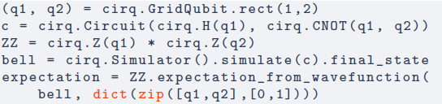

Cirq
Below we show example Cirq code for calculating the expectation value of $Z_{1}Z_{2}$for a Bell state:

Slide 45
II. SOFTWARE ARCHITECTURE & BUILDING BLOCKS B. TensorFlow

Slide 46
TensorFlow
TensorFlow is an end-to-end open source machine learning platform. It is a language for describing computations as stateful dataflow graphs.
Describing machine learning models as dataflow graphs is advantageous for performance during training.

Slide 47
TensorFlow
First, it is easy to obtain gradients of dataflow graphs using backpropagation, allowing efficient parameter updates.
Second, independent nodes of the computational graph may be distributed across independent machines, including GPUs and TPUs, and run in parallel.
These computational advantages established TensorFlow as a powerful tool for machine learning and deep learning.

Slide 48
TensorFlow
TensorFlow constructs this dataflow graph using tensors for the directed edges and operations (ops) for the nodes.
For our purposes, a rank n tensor is simply an n-dimensional array.
In TensorFlow, tensors are additionally associated with a data type, such as integer or string.

Slide 49
TensorFlow
In general, an op is a function mapping input tensors to output tensors.
Ops may act on zero or more input tensors, always producing at least one tensor as output.
For example, the addition op ingests two tensors and outputs one tensor representing the elementwise sum of the inputs.

Slide 50
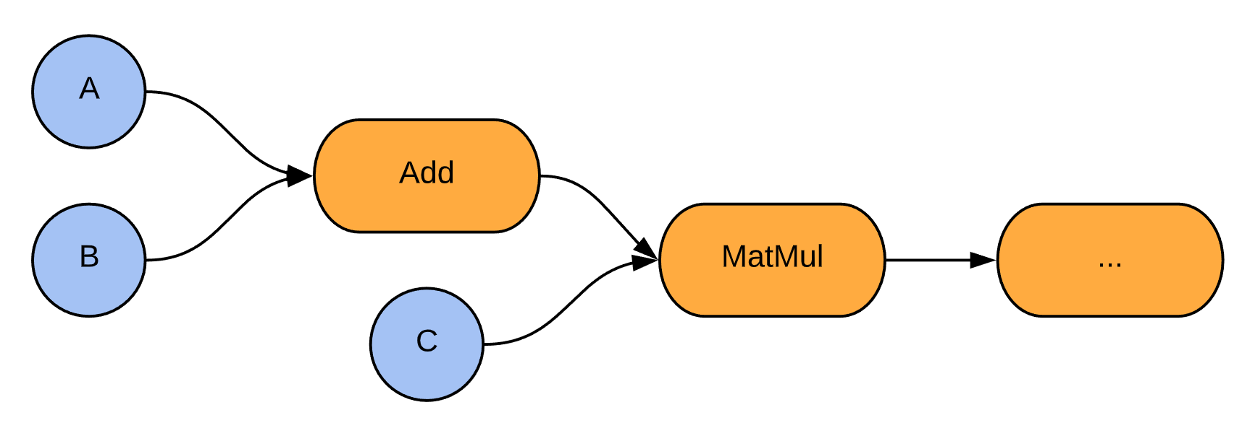
TensorFlow
Two tensor inputs A and B are added and then multiplied against a third tensor input C, before flowing on to further nodes in the graph.

Slide 51
TensorFlow
Blue nodes are tensor injections (ops), arrows are tensors flowing through the computational graph, and orange nodes are tensor transformations (ops).

Slide 52
TensorFlow
Tensor injections are ops in the sense that they are functions which take in zero tensors and output one tensor.

Slide 53
TensorFlow 2
The recently announced TensorFlow 2 takes the dataflow graph structure as a foundation and adds high-level abstractions.
One new feature is the Python function decorator @tf.function , which automatically converts the decorated function into a graph computation.
Also relevant is the native support for Keras.

Slide 54
TensorFlow 2
These abstractions allow the concise definition of machine learning models which ingest and process data, all backed by dataflow graph computation.
The combination of these high-level abstractions and efficient dataflow graph backend makes TensorFlow 2 an ideal platform for data-driven machine learning research.

Slide 55
II. SOFTWARE ARCHITECTURE & BUILDING BLOCKS D. TFQ architecture

Slide 56
D. TFQ architecture 1. Design Principles and Overview

Slide 57
Design Principles
In order to satisfy the diverse needs of the research community, we have arrived at the following four design principles:
Differentiability.
Circuit Batching.
3. Execution Backend
Agnostic.
4. Minimalism.

Slide 58
Differentiability
As described in the introduction, gradient-based methods leveraging autodifferentiation have become the leading heuristic for optimization of machine learning models.
A software framework for QML must support differentiation of quantum circuits so that hybrid quantum-classical models can participate in backpropagation.

Slide 59
Circuit Batching
Learning on quantum data requires re-running parameterized model circuits on each quantum data point.
A QML software framework must be optimized for running large numbers of such circuits.
Ideally, the semantics should match established TensorFlow norms for batching over data.

Slide 60
Execution Backend Agnostic
Experimental quantum computing often involves reconciling perfectly simulated algorithms with the outputs of real, noisy devices.
Thus, QML software must allow users to easily switch between running models in simulation and running models on real hardware, such that simulated results and experimental results can be directly compared.

Slide 61
Minimalism
Cirq provides an extensive set of tools for preparing quantum circuits. TensorFlow provides a very complete machine learning toolkit through its hundreds of ops and Keras high-level API, with a massive community of active users. Existing functionality in Cirq and TensorFlow should be used as much as possible.

Slide 62
Minimalism
TFQ should serve as a bridge between the two that does not require users to re-learn how to interface with quantum computers or re-learn how to solve problems using machine learning.

Slide 63
TFQ Overview
In TFQ, circuits and other quantum computing constructs are tensors, and converting these tensors into classical information via simulation or execution on a quantum device is done by ops.
These tensors are created by converting Cirq objects to TensorFlow string tensors, using the tfq.convert_to_tensor function.

Slide 64
TFQ Overview
This takes in a cirq.Circuit or cirq.PauliSum object and creates a string tensor representation.
The cirq.Circuit objects may be parameterized by SymPy symbols.
These tensors are then converted to classical information via sampling, expectation value calculation, or state simulation.
TFQ provides ops for each of these computations.

Slide 65
TFQ Overview
The code snippet on the next slide shows how a simple parameterized circuit may be created using Cirq, and its Z expectation evaluated at different parameter values using the tfq expectation value calculation op. We feed the output into the tf.math.abs op to show that tfq ops integrate naively with tf ops.

Slide 66
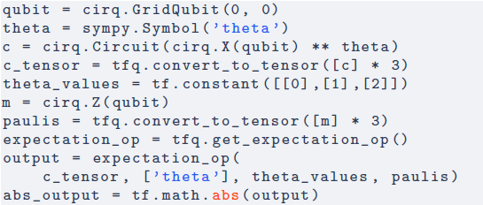
TFQ Overview

Slide 67
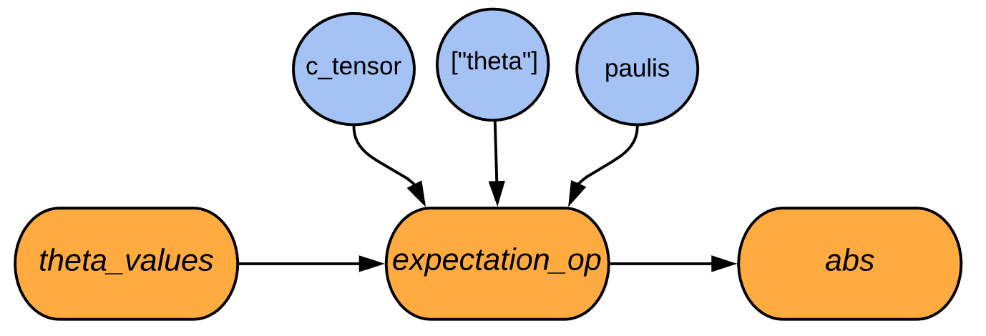
TFQ Overview
To calculate the expectation value of a parameterized circuit. The symbol values can come from other TensorFlow ops, such as from the outputs of a DNN.

Slide 68
TFQ Overview
The output can be passed on to other ops in the graph; here, for illustration, the output is passed to the absolute value op.

Slide 69
TFQ Overview
We supply the expectation op with a tensor of parameterized circuits, a list of symbols contained in the circuits, a tensor of values to use for those symbols, and a tensor of operators to measure with respect to them. Given this, it outputs a tensor of expectation values.

Slide 70
TFQ Overview
The expectation op is fully differentiable. Given that there are many ways to calculate the gradient of a quantum circuit with respect to its input parameters, TFQ allows expectation ops to be configured with one of many built-in differentiation methods using the tfq.differentiators.Differentiator interface, such as finite differencing, parameter shift rules, and various stochastic methods.

Slide 71
TFQ Overview
The tfq.differentiators.Differentiator interface also allows users to define their own gradient calculation methods for their specific problem if they desire.
The tensor representation of circuits and Paulis along with the execution ops are all that are required to solve any problem in QML.
The tools provided by TFQ can interact with both core TensorFlow and, via Cirq, real quantum hardware.

Slide 72
In the next section, we describe an abstract quantum machine learning pipeline for a hybrid model that TFQ was designed to support.
Then we illustrate the TFQ pipeline via a Hello Many-Worlds example, which involves building the simplest hybrid quantum-classical model for a binary classification task on a single qubit.
More detailed information on the building blocks of TFQ features will be given in section II E.

Slide 73
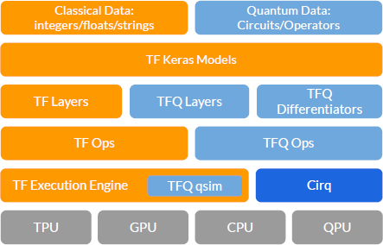
The software stack of TFQ
The software stack of TFQ, showing its interactions with TensorFlow, Cirq, and computational hardware.

Slide 74
The software stack of TFQ
At the top of the stack is the data to be processed. Classical data is natively processed by TensorFlow;

Slide 75
The software stack of TFQ
TFQ adds the ability to process quantum data, consisting of both quantum circuits and quantum operators.

Slide 76
The software stack of TFQ
The next level down the stack is the Keras API in TensorFlow.

Slide 77
The software stack of TFQ
Since a core principle of TFQ is native integration with core TensorFlow, in particular with Keras models and optimizers, this level spans the full width of the stack.

Slide 78
The software stack of TFQ
Underneath the Keras model abstractions are our TensorFlow Quantum layers and differentiators,

Slide 79
The software stack of TFQ
which enable hybrid quantum-classical automatic differentiation when connected with classical TensorFlow layers.

Slide 80
The software stack of TFQ
Underneath the layers and differentiators, we have TensorFlow ops, which instantiate the dataflow graph. Our custom ops control quantum circuit execution.

Slide 81
The software stack of TFQ
The circuits can be run in simulation mode, by invoking qsim or Cirq, or eventually will be executed on QPU hardware.

Slide 82
D. TFQ architecture 2. The Abstract TFQ Pipeline

Slide 83
The Abstract TFQ Pipeline
(1) Prepare Quantum Dataset
(2) Evaluate Quantum Model
(3) Sample or Average
(4) Evaluate Classical Model
(5) Evaluate Cost Function
(6) Evaluate Gradients & Update Parameters

Slide 84
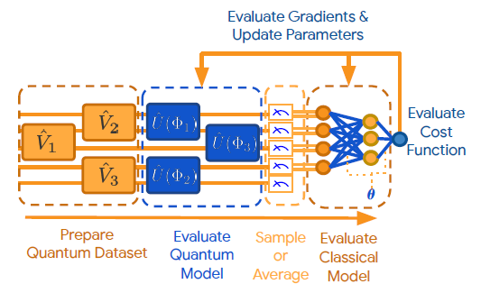
The Abstract TFQ Pipeline
Abstract pipeline for inference and training of a hybrid discriminative model in TFQ.

Slide 85
Prepare Quantum Dataset
In general, this might come from a given black-box source.
However, as current quantum computers cannot import quantum data from external sources, the user has to specify quantum circuits which generate the data.
Quantum datasets are prepared using unparameterized cirq.Circuit objects and are injected into the computational graph using tfq.convert_to_tensor .

Slide 86
Evaluate Quantum Model
Parameterized quantum models can be selected from several categories based on knowledge of the quantum data's structure.
The goal of the model is to perform a quantum computation in order to extract information hidden in a quantum subspace or quantum subsystem.
In the case of discriminative learning, this information is the hidden label parameters.

Slide 87
Evaluate Quantum Model
To extract a quantum non-local subsystem, the quantum model disentangles the input data, leaving the hidden information encoded in classical correlations, thus making it accessible to local measurements and classical post-processing.
Quantum models are constructed using cirq.Circuit objects containing SymPy symbols, and can be attached to quantum data sources using the tfq.layers.AddCircuit layer.

Slide 88
Sample or Average
Measurement of quantum states extracts classical information, in the form of samples from a classical random variable.
The distribution of values from this random variable generally depends on both the quantum state itself and the measured observable.

Slide 89
Sample or Average
As many variational algorithms depend on mean values of measurements, TFQ provides methods for averaging over several runs involving steps (1) and (2).
Sampling or averaging are performed by feeding quantum data and models to the tfq.layers.Sample or tfq.layers.Expectation layers.

Slide 90
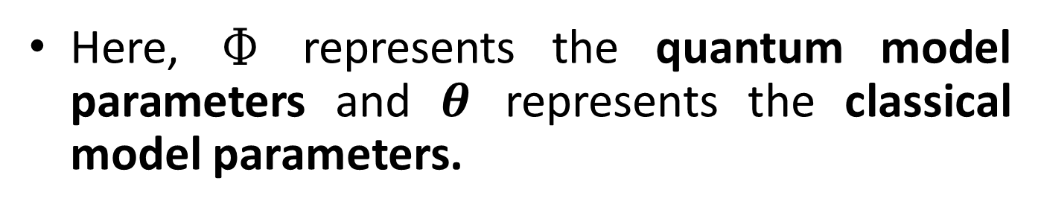
The Abstract TFQ Pipeline
Here, Ф represents the quantum model parameters and $θ$ represents the classical model parameters.

Slide 91
Evaluate Classical Model
Once classical information has been extracted, it is in a format amenable to further classical post-processing.
As the extracted information may still be encoded in classical correlations between measured expectations, classical deep neural networks can be applied to distill such correlations.

Slide 92
Evaluate Classical Model
Since TFQ is fully compatible with core TensorFlow, quantum models can be attached directly to classical tf.keras.layers.Layer objects such as tf.keras.layers.Dense .

Slide 93
Evaluate Cost Function
Given the results of classical post-processing, a cost function is calculated.
This may be based on the accuracy of classification if the quantum data was labeled, or other criteria if the task is unsupervised.
Wrapping the model built in stages (1) through (4) inside a tf.keras.Model gives the user access to all the losses in the tf.keras.losses module.

Slide 94
Evaluate Gradients & Update Parameters
After evaluating the cost function, the free parameters in the pipeline is updated in a direction expected to decrease the cost. This is most commonly performed via gradient descent.
To support gradient descent, TFQ exposes derivatives of quantum operations to the TensorFlow backpropagation machinery via the tfq.differentiators.Differentiator interface.

Slide 95
Evaluate Gradients & Update Parameters
This allows both the quantum and classical models' parameters to be optimized against quantum data via hybrid quantum-classical backpropagation.

Slide 96
The Abstract TFQ Pipeline
Here, Ф represents the quantum model parameters and $θ$ represents the classical model parameters.

Slide 97
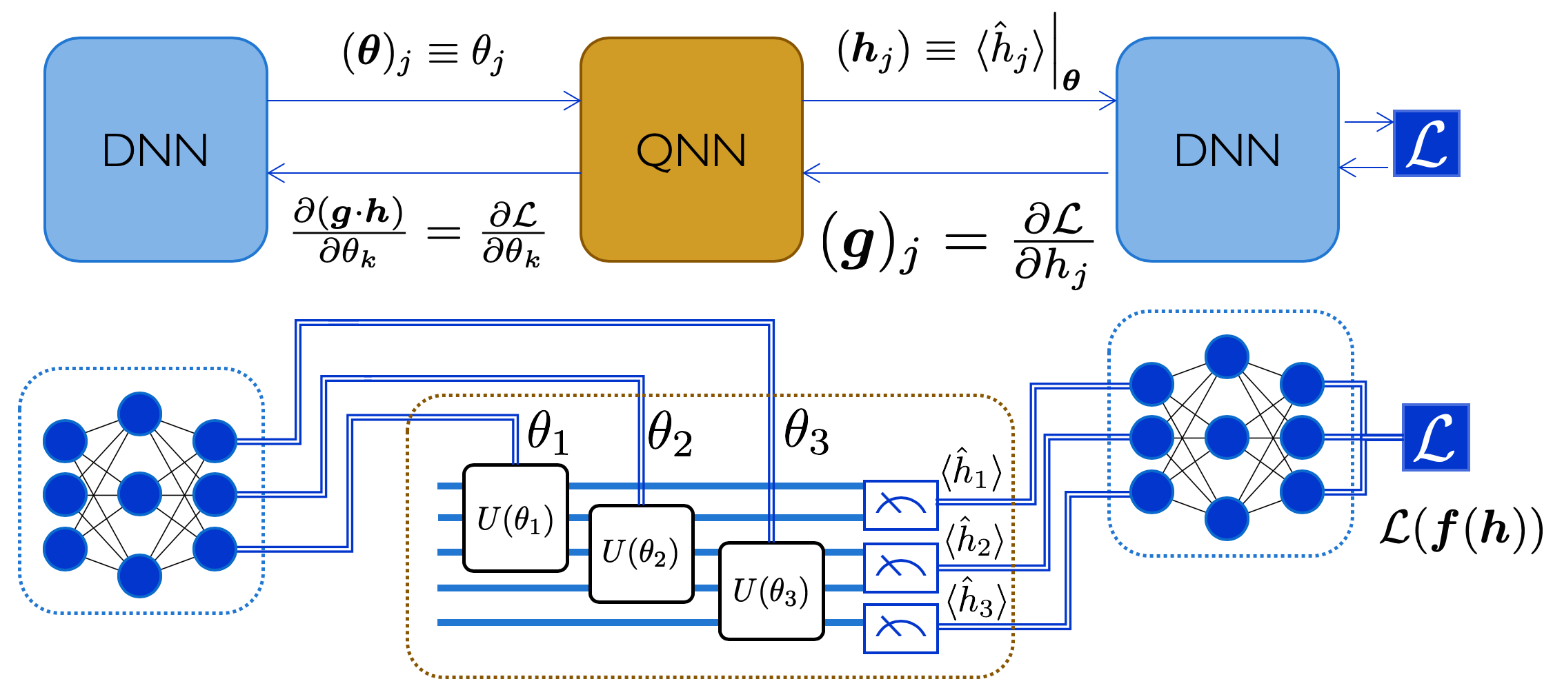
Example of inference and hybrid backpropagation at the interface of a quantum and classical part of a hybrid computational graph.

Slide 98
Here we have classical deep neural networks (DNN) both preceding and postceding the quantum neural network (QNN).

Slide 99
D. TFQ architecture 3. Hello Many-Worlds: Quantum Binary Classifier

Slide 100
Quantum Binary Classifier
Binary classification is a basic task in machine learning that can be applied to quantum data as well. As a minimal example of a hybrid quantum-classical model, we present here a binary classifier for regions on a single qubit.

Slide 101
Quantum Binary Classifier
In this task, two random vectors in the X-Z plane of the Bloch sphere are chosen. Around these two vectors, we randomly sample two sets of quantum data points; the task is to learn to distinguish the two sets.

Slide 102
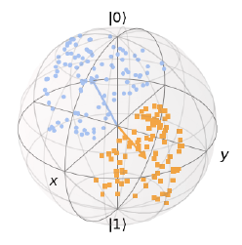
Quantum Dataset
Quantum data represented on the Bloch sphere. States in category a are blue, while states in category b are orange.

Slide 103
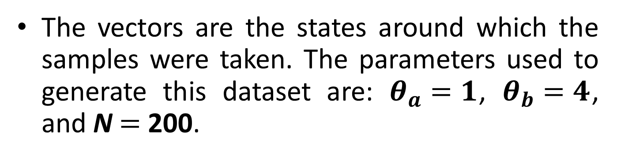
Quantum Dataset
The vectors are the states around which the samples were taken. The parameters used to generate this dataset are: $θ_{a}=1$, $θ_{b}=4$, and N $=$ 200.

Slide 104

Quantum Binary Classifier
The first step is to generate the quantum data. We can use Cirq for this task. The common imports required for working with TFQ are shown below:
The function on the next slide generates the quantum dataset; labels use a one-hot encoding:

Slide 105
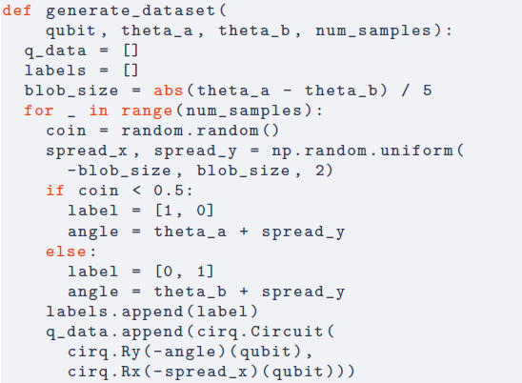

Slide 106
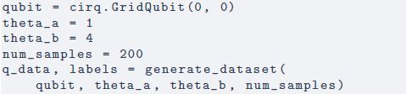
Quantum Binary Classifier
We can generate a dataset and the associated labels after picking some parameter values:

Slide 107
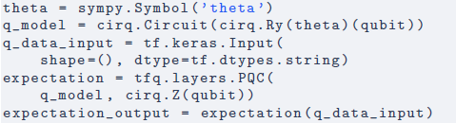
Quantum Binary Classifier
As our quantum parametric model, we use the simplest case of a universal quantum discriminator, a single parameterized rotation (linear) and measurement along the Z axis (non-linear):

Slide 108
Quantum Binary Classifier
The purpose of the rotation gate is to minimize the superposition from the input quantum data such that we can get maximum useful information from the measurement.

Slide 109
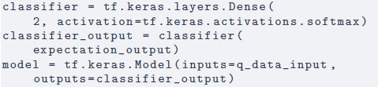
Quantum Binary Classifier
This quantum model is then attached to a small classifier NN to complete our hybrid model. Notice in the code below that quantum layers can appear among classical layers inside a standard Keras model:

Slide 110

Quantum Binary Classifier
We can train this hybrid model on the quantum data defined earlier. Below we use as our loss function the cross entropy between the labels and the predictions of the classical NN; the ADAM optimizer is chosen for parameter updates.

Slide 111

Quantum Binary Classifier
Finally, we can use our trained hybrid model to classify new quantum datapoints:
The following section IIE. reviews the features of TFQ in a more API reference inspired style.

Slide 112
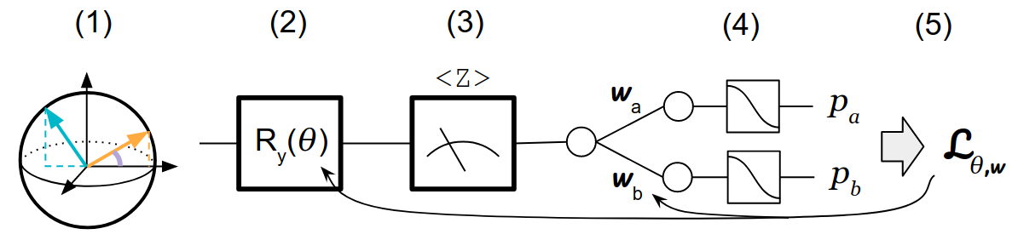
The Abstract TFQ Pipeline of Quantum Binary Classifier
The abstract TFQ pipeline of one-qubit quantum binary classifier.

Slide 113
The Abstract TFQ Pipeline of Quantum Binary Classifier
(1) Quantum data to be classified.

Slide 114
The Abstract TFQ Pipeline of Quantum Binary Classifier
(2) Parameterized rotation gate, whose job is to remove superpositions in the quantum data.

Slide 115
The Abstract TFQ Pipeline of Quantum Binary Classifier
(3) Measurement along the Z axis of the Bloch sphere converts the quantum data into classical data.

Slide 116
The Abstract TFQ Pipeline of Quantum Binary Classifier
(4) Classical post-processing is a two-output SoftMax layer, which outputs probabilities for the quantum data to come from category a or category b.

Slide 117
The Abstract TFQ Pipeline of Quantum Binary Classifier
(5) Categorical cross entropy is computed between the predictions and the labels.

Slide 118
The Abstract TFQ Pipeline of Quantum Binary Classifier
(5) The Adam optimizer is used to update both the quantum and classical portions of the hybrid model.

Slide 119
II. SOFTWARE ARCHITECTURE & BUILDING BLOCKS E. TFQ Building Blocks

Slide 120
TFQ Building Blocks
Having provided a minimum working example in the previous section, we now seek to provide more details about the components of the TFQ framework.
First, we describe how quantum computations specified in Cirq are converted to tensors for use inside the TensorFlow graph.
Then, we describe how these tensors can be combined in-graph to yield larger models.

Slide 121
TFQ Building Blocks
Next, we show how circuits are simulated and measured in TFQ.
The core functionality of the framework, differentiation of quantum circuits, is then explored.
Finally, we describe our more abstract layers, which can be used to simplify many QML workflows.

Slide 122
E. TFQ Building Blocks 1. Quantum Computations as Tensors

Slide 123
Quantum Computations as Tensors
As pointed out in section II A, Cirq already contains the language necessary to express quantum computations, parameterized circuits, and measurements.
Guided by principle 4, TFQ should allow direct injection of Cirq expressions into the computational graph of TensorFlow.
This is enabled by the tfq.convert_to_tensor function.

Slide 124
Quantum Computations as Tensors
We saw the use of this function in the quantum binary classier, where a list of data generation circuits specified in Cirq was wrapped in this function to promote them to tensors.

Slide 125
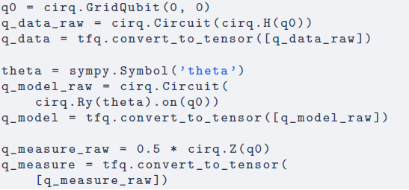
Quantum Computations as Tensors
Below we show how a quantum data point, a quantum model, and a quantum measurement can be converted into tensors:

Slide 126
Quantum Computations as Tensors
This conversion is backed by our custom serializers. Once a Circuit or PauliSum is serialized, it becomes a tensor of type tf.string . This is the reason for the use of tf.keras.Input(shape=(),dtype=tf.dtypes.string) when creating inputs to Keras models, as seen in the quantum binary classifier example.

Slide 127
E. TFQ Building Blocks 2. Composing Quantum Models

Slide 128
Composing Quantum Models
After injecting quantum data and quantum models into the computational graph, a custom TensorFlow operation is required to combine them. In support of guiding principle 2, TFQ implements the tfq.layers.AddCircuit layer for combining tensors of circuits.

Slide 129
Composing Quantum Models
In the following code, we use this functionality to combine the quantum data point and quantum model defined in subsection IIE1:

Slide 130
Composing Quantum Models
To quantify the performance of a quantum model on a quantum dataset, we need the ability to define loss functions. This requires converting quantum information into classical information.

Slide 131
Composing Quantum Models
This conversion process is accomplished by either sampling the quantum model, which stochastically produces bitstrings according to the probability amplitudes of the model, or by specifying a measurement and taking expectation values.

Slide 132
E. TFQ Building Blocks 3. Sampling and Expectation Values

Slide 133
Sampling and Expectation Values
Sampling from quantum circuits is an important use case in quantum computing. The recently achieved milestone of quantum supremacy is one such application, in which the difficulty of sampling from a quantum model was used to gain a computational edge over classical machines.

Slide 134
Sampling and Expectation Values
TFQ implements tfq.layers.Sample , a Keras layer which enables sampling from batches of circuits in support of design objective 2.
The user supplies a tensor of parameterized circuits, a list of symbols contained in the circuits, and a tensor of values to substitute for the symbols in the circuit.

Slide 135
Sampling and Expectation Values
Given these, the Sample layer produces a tf.RaggedTensor of shape [batch_size, num_samples, n_qubits] , where the n_qubits dimension is ragged to account for the possibly varying circuit size over the input batch of quantum data.

Slide 136

Sampling and Expectation Values
For example, the following code takes the combined data and model from section IIE2 and produces a tensor of size [1, 4, 1] containing four single-bit samples:

Slide 137
Sampling and Expectation Values
Though sampling is the fundamental interface between quantum and classical information, differentiability of quantum circuits is much more convenient when using expectation values, as gradient information can then be backpropagated (see section III for more details).

Slide 138
Sampling and Expectation Values
In the simplest case, expectation values are simply averages over samples. In quantum computing, expectation values are typically taken with respect to a measurement operator M. This involves sampling bitstrings from the quantum circuit as described above, applying M to the list of bitstring samples to produce a list of numbers, then taking the average of the result.

Slide 139
Sampling and Expectation Values
In contrast to sampling (which is by default in the standard computational basis, the Z eigenbasis of all qubits), taking expectation values requires defining a measurement.
As discussed in section II A, these are first defined as cirq.PauliSum objects and converted to tensors.

Slide 140
Sampling and Expectation Values
TFQ implements tfq.layers.Expectation , a Keras layer which enables the extraction of measurement expectation values from quantum models.

Slide 141
Sampling and Expectation Values
The user supplies a tensor of parameterized circuits, a list of symbols contained in the circuits, a tensor of values to substitute for the symbols in the circuit, and a tensor of operators to measure with respect to them. Given these inputs, the layer outputs a tensor of expectation values.

Slide 142
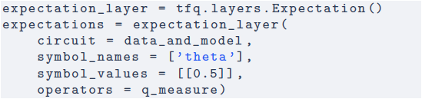
Sampling and Expectation Values
Below, we show how to take an expectation value of the measurement defined in section IIE1:

Slide 143
Sampling and Expectation Values
The expectation layer is capable of using either a simulator or a real device for execution, and this choice is simply specified at run time.
Having converted the output of a quantum model into classical information, the results can be fed into subsequent computations. In particular, they can be fed into functions that produce a single number, allowing us to define loss functions over quantum models in the same way we do for classical models.

Slide 144
E. TFQ Building Blocks 4. Differentiating Quantum Circuits

Slide 145
Differentiating Quantum Circuits
We have taken the first steps towards implementation of quantum machine learning, having defined quantum models over quantum data and loss functions over those models. As described in both the introduction and our first guiding principle, differentiability is the critical machinery needed to allow training of these models.

Slide 146
Differentiating Quantum Circuits
As described in section II B, the architecture of TensorFlow is optimized around backpropagation of errors for efficient updates of model parameters; one of the core contributions of TFQ is integration with TensorFlow's backpropagation mechanism.

Slide 147
Differentiating Quantum Circuits
TFQ implements this functionality with our differentiators module. The theory of quantum circuit differentiation will be covered in section III C; here, we overview the software that implements the theory.

Slide 148
Differentiating Quantum Circuits
Since there are many ways to calculate gradients of quantum circuits, TFQ provides the tfq.differentiators.Differentiator interface.
Our Expectation and SampledExpectation layers rely on classes inheriting from this interface to specify how TensorFlow should compute their gradients.

Slide 149
Differentiating Quantum Circuits
While advanced users can implement their own custom differentiators by inheriting from the interface, TFQ comes with several built-in options, two of which we highlight here.
These two methods are instances of the two main categories of quantum circuit differentiators: the finite difference methods and the parameter shift methods.

Slide 150
Finite Difference Methods
The first class of quantum circuit differentiators is the finite difference methods. This class samples the primary quantum circuit for at least two different parameter settings, then combines them to estimate the derivative.

Slide 151
Finite Difference Methods
The ForwardDifference differentiator provides most basic version of this.
For each parameter in the circuit, the circuit is sampled at the current setting of the parameter. Then, each parameter is perturbed separately and the circuit resampled.

Slide 152
Parameter Shift Methods
For the 2-local circuits implementable on near-term hardware, methods more sophisticated than finite differences are possible.
These methods involve running an ancillary quantum circuit, from which the gradient of the primary circuit with respect to some parameters can be directly measured.

Slide 153
Parameter Shift Methods
One specific method is gate decomposition and parameter shifting, implemented in TFQ as the ParameterShift differentiator.
For in-depth discussion of the theory, see section IIIC2.

Slide 154

Parameter Shift Methods
Below, we show the expectation layer being called with our parameter shift rule:

Slide 155
E. TFQ Building Blocks 5. Simplified Layers

Slide 156
Simplified Layers
Some workflows do not require control as sophisticated as our Expectation , Sample , and SampledExpectation layers allow. For these workflows we provide the PQC and ControlledPQC layers.
Both of these layers allow parameterized circuits to be updated by hybrid backpropagation without the user needing to provide the list of symbols associated with the circuit.

Slide 157
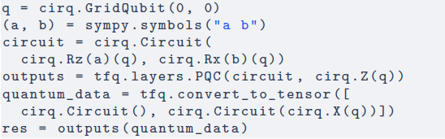
Simplified Layers
The PQC layer provides automated Keras management of the variables in a parameterized circuit:

Slide 158
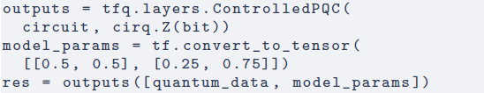
Simplified Layers
When the variables in a parameterized circuit will be controlled completely by other user-specified machinery, for example by a classical neural network, then the user can call our ControlledPQC layer:

Slide 159
Simplified Layers
Notice that the call of ControlledPQC is similar to that for PQC, except that we provide parameter values for the symbols in the circuit.
These two layers are used extensively in the applications highlighted in the following sections.

